Slide 1
SOFTWARE ENGINEERING
Course Outline
Software Project Management
Dr Prabhat Kumar Vishwakarma

Slide 2
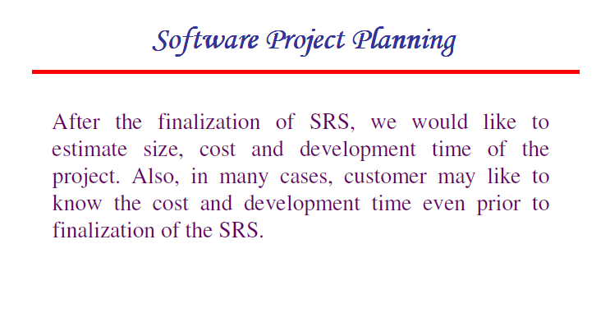
SOFTWARE ENGINEERING
Dr Prabhat Kumar Vishwakarma

Slide 3
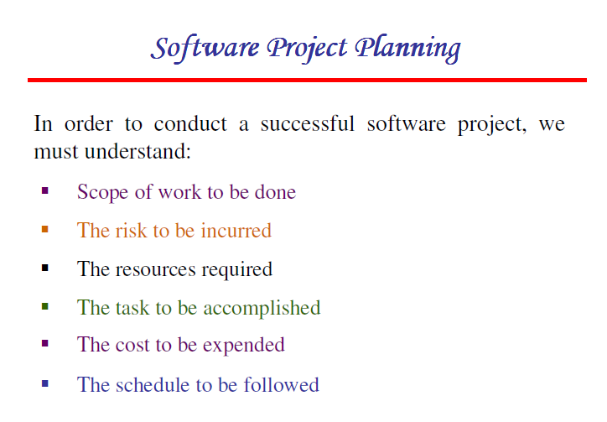
SOFTWARE ENGINEERING
Dr Prabhat Kumar Vishwakarma

Slide 4
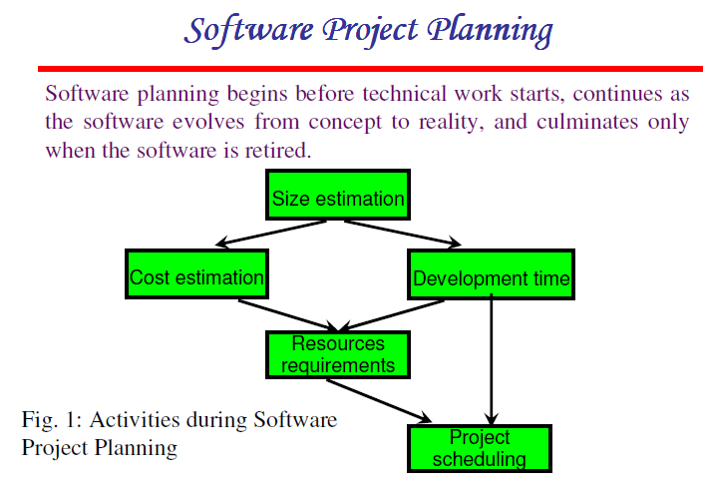
SOFTWARE ENGINEERING
Dr Prabhat Kumar Vishwakarma

Slide 5
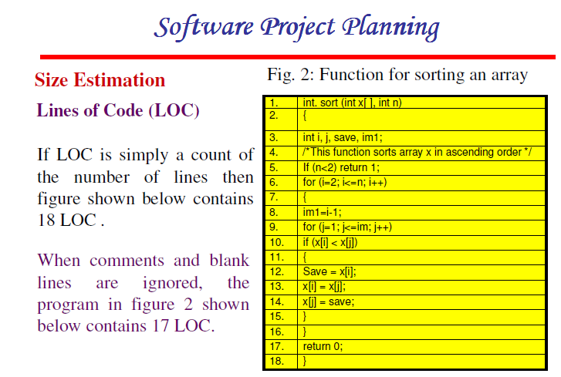
SOFTWARE ENGINEERING
Dr Prabhat Kumar Vishwakarma

Slide 6
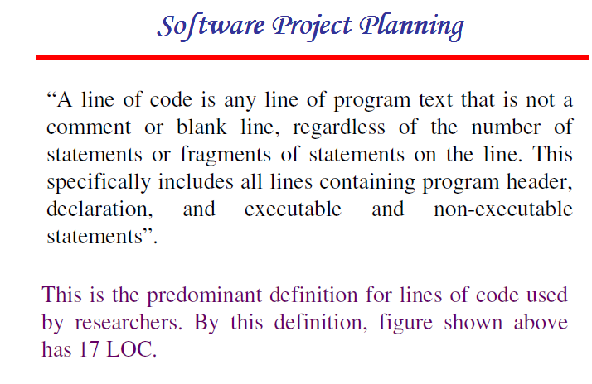
SOFTWARE ENGINEERING
Dr Prabhat Kumar Vishwakarma

Slide 7
SOFTWARE ENGINEERING
SOFTWARE PROJECT MANAGEMENT
Effective software project management focuses on the four P’s: people, product, process, and project. The order is not arbitrary. The manager who forgets that soft- ware engineering work is an intensely human endeavor will never have success in project management. A manager who fails to encourage comprehensive customer communication early in the evolution of a project risks building an elegant solution for the wrong problem. The manager who pays little attention to the process runs the risk of inserting competent technical methods and tools into a vacuum
Dr Prabhat Kumar Vishwakarma

Slide 8
SOFTWARE ENGINEERING
SOFTWARE PROJECT MANAGEMENT
PEOPLE
the “people factor” is so important that the Software Engineering Institute has developed a people management capability maturity model (PM-CMM), “to enhance the readiness of software organizations to undertake increasingly complex applications by helping to attract, grow, motivate, deploy, and retain the talent needed to improve their software development capability.
The people management maturity model defines the following key practice areas for software people: recruiting, selection, performance management, training, compensation, career development, organization and work design, and team/culture development. Organizations that achieve high levels of maturity in the people management area have a higher likelihood of implementing effective software engineering practices.
Dr Prabhat Kumar Vishwakarma

Slide 9
SOFTWARE ENGINEERING
SOFTWARE PROJECT MANAGEMENT
PRODUCT
Before a project can be planned, product objectives and scope should be established, alternative solutions should be considered, and technical and management constraints should be identified. Without this information, it is impossible to define reasonable (and accurate) estimates of the cost, an effective assessment of risk, a realistic breakdown of project tasks, or a manageable project schedule that provides a meaningful indication of progress.
Dr Prabhat Kumar Vishwakarma

Slide 10
SOFTWARE ENGINEERING
SOFTWARE PROJECT MANAGEMENT
PROCESS
A software process provides the framework from which a comprehensive plan for software development can be established. A small number of framework activities are applicable to all software projects, regardless of their size or complexity. A number of different task sets—tasks, milestones, work products, and quality assurance points—enable the framework activities to be adapted to the characteristics of the software project and the requirements of the project team. Finally, umbrella activities—such as software quality assurance, software configuration management, and measurement—overlay the process model. Umbrella activities are independent of any one framework activity and occur throughout the process.
Dr Prabhat Kumar Vishwakarma

Slide 11
SOFTWARE ENGINEERING
SOFTWARE PROJECT MANAGEMENT
PROJECT
In order to avoid project failure, a software project manager and the software engineers who build the product must avoid a set of common warning signs, understand the critical success factors that lead to good project management, and develop a commonsense approach for planning, monitoring and controlling the project
Dr Prabhat Kumar Vishwakarma

Slide 12
SOFTWARE ENGINEERING
SOFTWARE PROJECT MANAGEMENT
The Player
The software process (and every software project) is populated by players who can be categorized into one of five constituencies:
Senior managers who define the business issues that often have significant influence on the project.
Project (technical) managers who must plan, motivate, organize, and control the practitioners who do software work.
Practitioners who deliver the technical skills that are necessary to engineer a product or application.
Customers who specify the requirements for the software to be engineered and other stakeholders who have a peripheral interest in the outcome.
End-users who interact with the software once it is released for production use.
Dr Prabhat Kumar Vishwakarma

Slide 13
SOFTWARE ENGINEERING
SOFTWARE PROJECT MANAGEMENT
Project Team Structure
The “best” team structure depends on the management style of organization, the number of people who will populate the team and their skill levels, and the overall problem difficulty
Democratic decentralized (DD). This software engineering team has no permanent leader. Rather, "task coordinators are appointed for short durations and then replaced by others who may coordinate different tasks." Decisions on problems and approach are made by group consensus. Communication among team members is horizontal.
Controlled decentralized (CD). This software engineering team has a defined leader who coordinates specific tasks and secondary leaders that have responsibility for subtasks. Problem solving remains a group activity, but implementation of solutions is partitioned among subgroups by the team leader. Communication among subgroups and individuals is horizontal. Vertical com- munication along the control hierarchy also occurs.
Controlled Centralized (CC). Top-level problem solving and internal team coordination are managed by a team leader. Communication between the leader and team members is vertical.
Dr Prabhat Kumar Vishwakarma

Slide 14
SOFTWARE ENGINEERING
SOFTWARE PROJECT MANAGEMENT
Software Metric
Software metrics refers to a broad range of measurements for computer software. Measurement can be applied to the software process with the intent of improving it on a continuous basis. Measurement can be used throughout a software project to assist in estimation, quality control, productivity assess- ment, and project control. Finally, measurement can be used by software engi- neers to help assess the quality of technical work products and to assist in
tactical decision making as a project proceeds. Within the context of software project management, we are concerned primarily with productivity and quality metrics—measures of software development "output" as a function of effort and time applied and measures of the "fitness for use" of the work products that are produced.
Dr Prabhat Kumar Vishwakarma

Slide 15
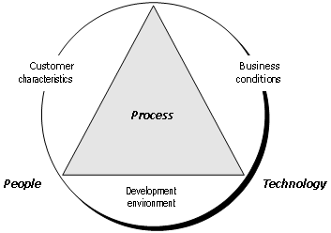
SOFTWARE ENGINEERING
SOFTWARE PROJECT MANAGEMENT
    Process Metrics and Software Process Improvement
    Product
Referring to diagram process sits at the center of a triangle connecting three factors that have a profound influence on software quality and organizational performance. The skill and motivation of people has been shown [BOE81] to be the single most influential factor in quality and performance.
Dr Prabhat Kumar Vishwakarma

Slide 16
SOFTWARE ENGINEERING
SOFTWARE PROJECT MANAGEMENT
    Process Metrics and Software Process Improvement
The complexity of the product can have a substantial impact on quality and team performance. The technology (i.e., the software engineering methods) that populate the process also has an impact. In addition, the process triangle exists within a circle of environmental conditions that include the development environment (e.g., CASE tools), business conditions (e.g., deadlines, business rules), and customer characteristics (e.g., ease of communication).
We measure the efficacy of a software process indirectly. That is, we derive a set of metrics based on the outcomes that can be derived from the process. Outcomes include measures of errors uncovered before release of the software, defects delivered to and reported by end-users, work products delivered (productivity), human effort expended, calendar time expended, schedule conformance, and other measures.
Dr Prabhat Kumar Vishwakarma

Slide 17
SOFTWARE ENGINEERING
SOFTWARE PROJECT MANAGEMENT
Project Metrics
Software process metrics are used for strategic purposes. Software project measures are tactical. That is, project metrics and the indicators derived from them are used by a project manager and a software team to adapt project work flow and technical activities.
The first application of project metrics on most software projects occurs during estimation. Metrics collected from past projects are used as a basis from which effort and time estimates are made for current software work. As a project proceeds, measures of effort and calendar time expended are compared to original estimates (and the project schedule). The project manager uses these data to monitor and control progress.
Dr Prabhat Kumar Vishwakarma

